Slide 1
<h1>FIRST WEEK</h1>
(Actually 6th)
László Szentesi

Slide 2


LINQ, Lambda

Slide 3
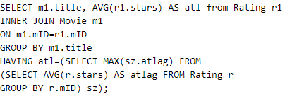
SQL
Find the movie(s) with the lowest average rating. Return the movie title(s) and average rating.

Slide 4
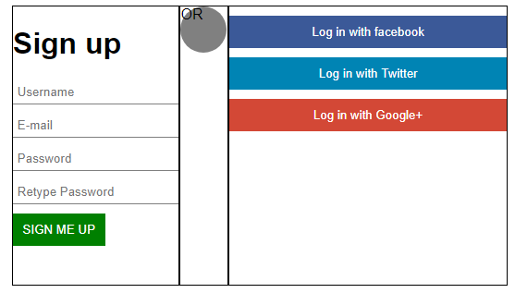
HTML/javascript

Slide 5
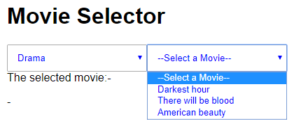
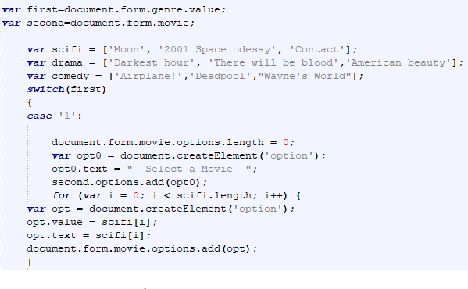
HTML/javascript

Slide 6
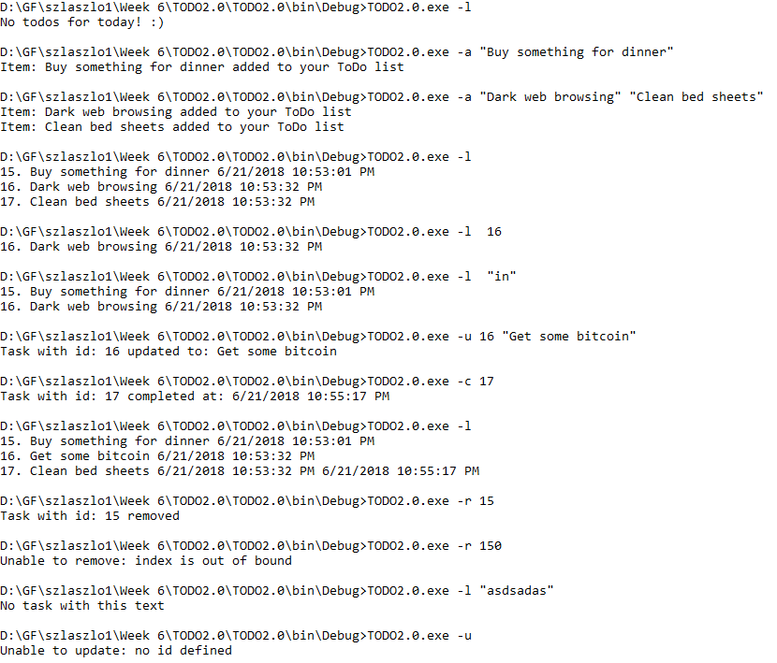
TODO

